Slide 1
Understanding Socio-Economic Dynamics in France
Insights into population, establishments, salaries & gender inequalities
Presented by Stéphanie PRAGASSAM | IRONHACK | DATA ANALYTICS | APRIL 2024

Slide 2
01
02
03
04
TABLE OF CONTENTS
05
INTRODUCTION
Goals & Project planning
DATA GATHERING
Flat files | API | Web Scrap | BigQuery
DATA PREPARATION
Data Cleaning & Wrangling | SQL
DATA EXPLORING
EDA & Visualization
DATA DISPLAYING
French Population, Establishments, and Salaries Insights API
06
MACHINE LEARNING
Gender pay gap prediction
07
CHALLENGES | NEXT STEPS
1

Slide 3
01
INTRODUCTION
On November 6, 2023, at 11:25 a.m., women in France began working for free compared to men, highlighting the ongoing gender pay gap issue
In 2020, this disparity was evident on November 4, at 04:16 p.m
2

Slide 4
INTRODUCTION
Analyzing socio-economic factors in France, including population demographics, establishment distributions, and job categories
Leveraging datasets from the French National Institute of Statistics and Economic Studies (INSEE) from 2020
Focusing on gender inequalities in the labor market, particularly in salary structures and representation in leadership roles
Aim to uncover patterns and trends through advanced data analysis to inform policy-making and promote socio-economic progress
3

Slide 5
Goals & Project Planning
4

Slide 6
To illuminate socio-economic dynamics in France and advocate for a more inclusive future…
Explore demographic trends and disparities in France
Investigate the representation of women in managerial positions
GOALS
Analyze salary distributions across different demographics and job categories
Identify correlations between population demographics and establishment data
5

Slide 7

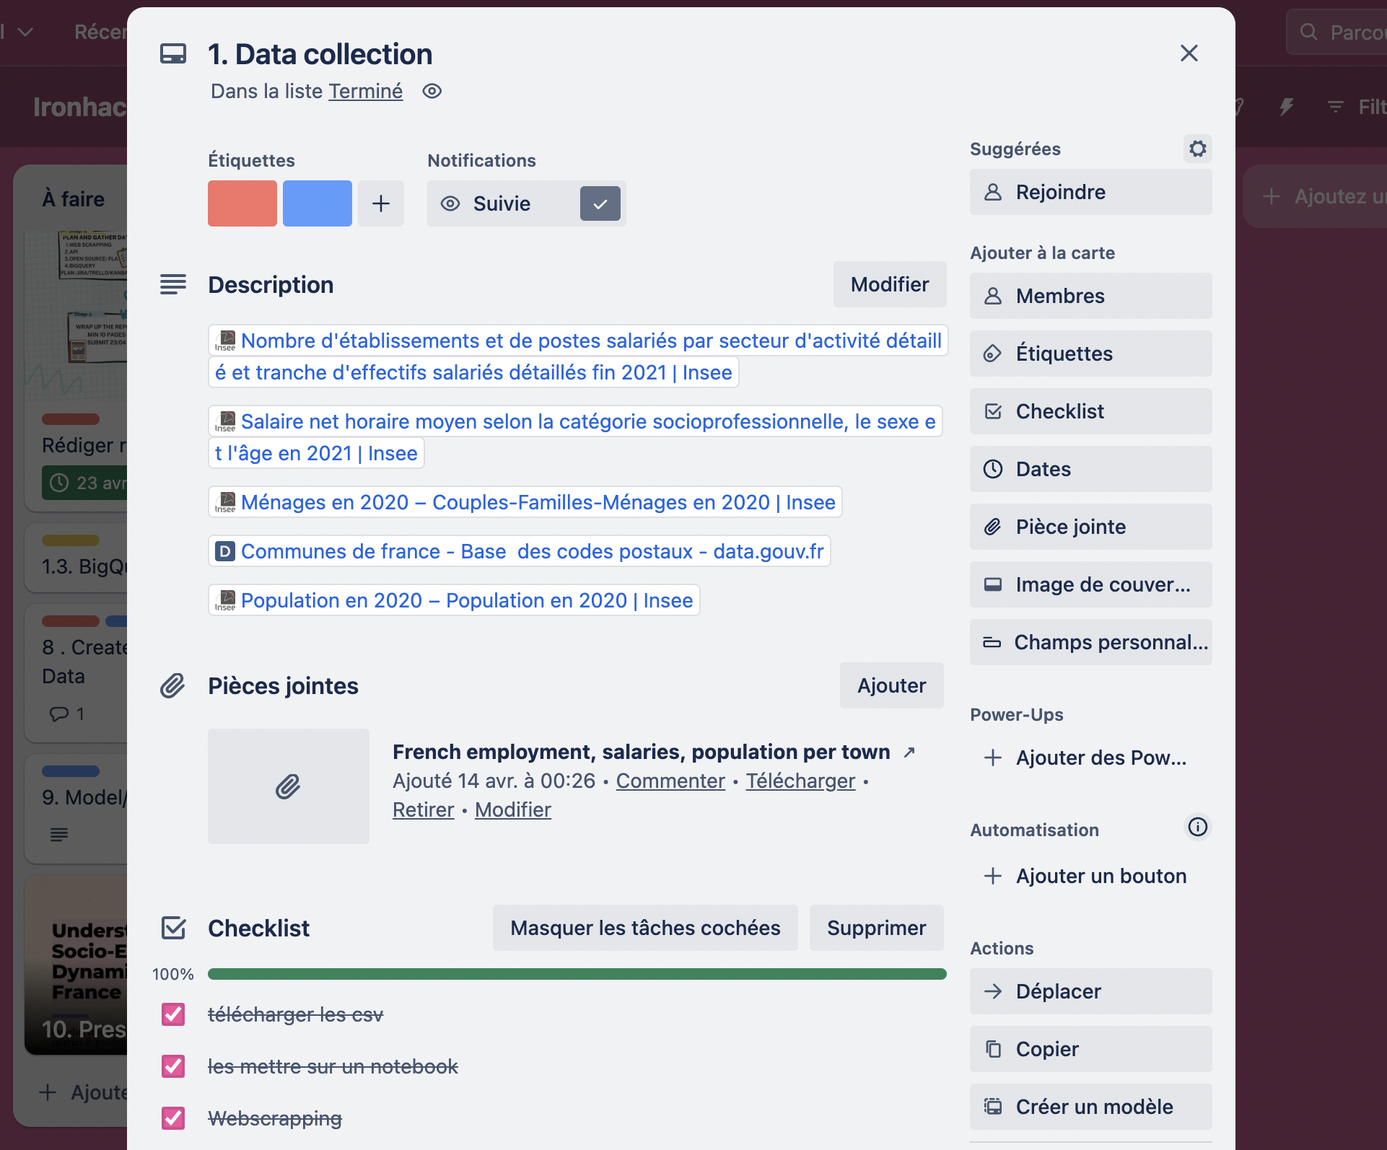
TRELLO FOR PROJECT PLANNING
6

Slide 8
02
DATA GATHERING
Flat files | API | Web Scrap | BigQuery
7

Slide 9
DATA GATHERING
01
FLAT FILES
INSEE datasets and data.gouv.fr platform
02
API
DATA SOURCES
United Nations Statistics Division SDG API
03
WEBSCRAP
Wikipedia page on professions and socio-professional categories
04
BIG QUERY
Cleaned CSV files uploaded for query execution
8

Slide 10
DATA GATHERING
Reliable sources: National Institute of Statistics and Economic Studies (INSEE) & data.gouv.fr platform
SOURCES
FLAT FILES
2020
DATA YEAR
Ensures consistency, reliability, and completeness in analysis, facilitating meaningful comparisons across different variables and indicators.
RATIONALE
9

Slide 11
DATA GATHERING : FLAT FILES
Number of Active Establishments
Description: Provides insights into the distribution of establishments across five major sectors.
Source: INSEE
File: etablissement.csv | Rows: 34,980 | Columns: 61
Average Net Hourly Wage
Description: Details average net hourly wage by socio-professional category, gender, and age.
Source: INSEE
File: salaire_par_commune.csv | Rows: 5,421 | Columns: 25
10

Slide 12
DATA GATHERING : FLAT FILES
Population Demographics
Description: Presents demographic information on population over 15 years old by gender, age, and socio-professional category
Source: INSEE
File: population.csv | Rows: 1,738,965 | Columns: 7
French Municipalities - Base of Postal Codes
Description: Includes names of regions, departments, and municipalities along with their respective INSEE codes
Source: La Poste - data.gouv.fr
File: communes-departement-region.csv | Rows: 5,421 | Columns: 15
11

Slide 13
DATA GATHERING : API
Accessible data related to the proportion of women in managerial roles from 2000 to 2022
Description
United Nations Statistics Division SDG API
Target : 5.5 - Insights into women's leadership participation
Parameters
Area code : 250 - France
‘api_data5.5_raw.csv’
Rows: 140 | Columns: 25
File
12

Slide 14
DATA GATHERING : WEBSCRAPING
Table of correspondence between socio-professional categories (PCS) and groups
- Statistical classification of occupations established by the INSEE in 1982 -
Description
fr.wikipedia.org
Parameters
Target : 3rd table of the webpage
- Professions et catégories socioprofessionnelles en France
‘cat_job_webscrap_raw.csv’
Rows: 42 | Columns: 4
File
13
Notes:
For the collection of data on professions and socio-professional categories (PCS), we utilized web scraping techniques to extract information from the Wikipedia page titled "Professions et catégories socioprofessionnelles en France." Specifically, we focused on retrieving data from the third table on the page, which provides the correspondence between socio-professional categories and socio-professional groups.
The professions and socio-professional categories (PCS) serve as a statistical classification system used to categorize occupations. This classification was established by the National Institute of Statistics and Economic Studies (INSEE) in 1982. By scraping this data from Wikipedia, we were able to obtain more insights into the classification of professions and socio-professional categories, which are essential for our analysis of various socio-economic factors in France.
URL: https://fr.wikipedia.org/wiki/Professions_et_cat%C3%A9gories_socioprofessionnelles_en_France
Data from webscraping : ‘cat_job_webscrap_raw.csv’
Shape = Rows : 42 - Columns : 4

Slide 15
03
DATA PREPARATION
Data Cleaning & Wrangling |
SQL : Database creation | ERD | Queries |
14
Notes:
Once the data collection phase was completed, the subsequent task involved cleaning the
gathered data to construct the database and ensure its readiness for utilization in both the
API and the machine learning model.

Slide 16
DATA CLEANING & WRANGLING
Handling null values, duplicates
Value formating
CLEANING
Renaming, dropping & reorganizing columns
WRANGLING
Reduce the number of categories (age groups & firm sizes)
Data homogenization & normalization
*Notebook available in the Github Repository
15

Slide 17
AFTER CLEANING
population*
salary
Shape : 826,266 x 6
Before : 1,738,965 x 7
Shape : 10,842 x 10
Before : 5,421 x 25
establishment
Cleaned datasets
woman_managerial_position
Shape : 34,980 x 11
Before : 34,980 x 61
Shape : 19 x 4
Before : 140 x 25
geography
french_cat_job
Shape : 36,370 x 10
Before : 5,421 x 15
Shape : 42 x 4
16

Slide 18
AFTER CLEANING
population*
salary**
Shape : 826,266 x 6
Before : 1,738,965 x 7
Shape : 10,842 x 10
Before : 5,421 x 25
establishment
Cleaned datasets
woman_managerial_position
Shape : 34,980 x 11
Before : 34,980 x 61
Shape : 19 x 4
Before : 140 x 25
geography
french_cat_job
Shape : 36,370 x 10
Before : 5,421 x 15
Shape : 42 x 4
*population_all = population before age grouping
**salary_all = salary before normalization (male/female)
17

Slide 19
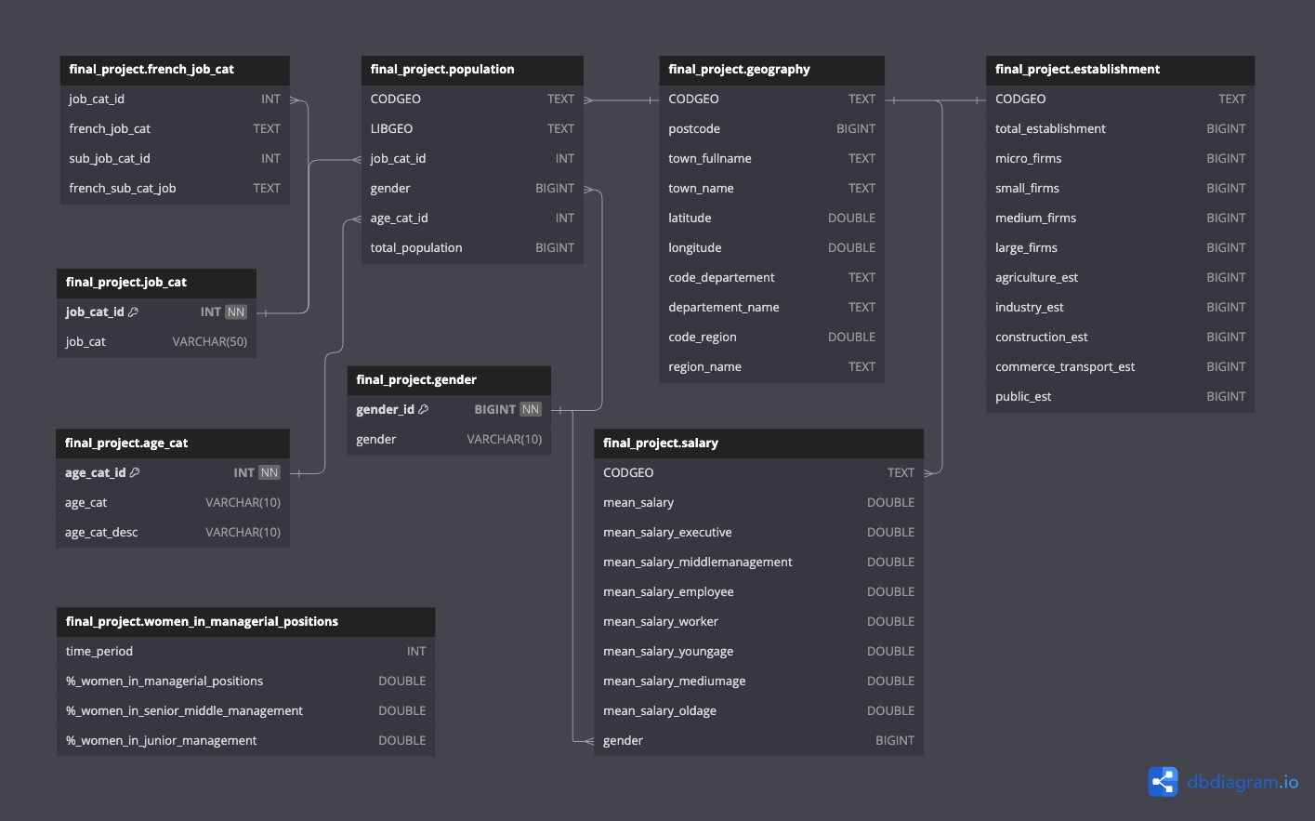
ERD
SQL DATABASE CREATION :
‘final_project’
18

Slide 20
SQL QUERIES* used for …
Pearson Corr.
for EDA
Views for API
endpoints
between total population
& establishments
with joint tables & new aggregated columns
Paygap
for Tableau
TOP 10
for EDA
exported as .csv from MySQL & uploaded for visualization
highest & lowest gender pay gap by department
*SQL script available in the Github Repository
19

Slide 21
04
DATA EXPLORING
Exploratory Data Analysis & Visualization
20

Slide 22
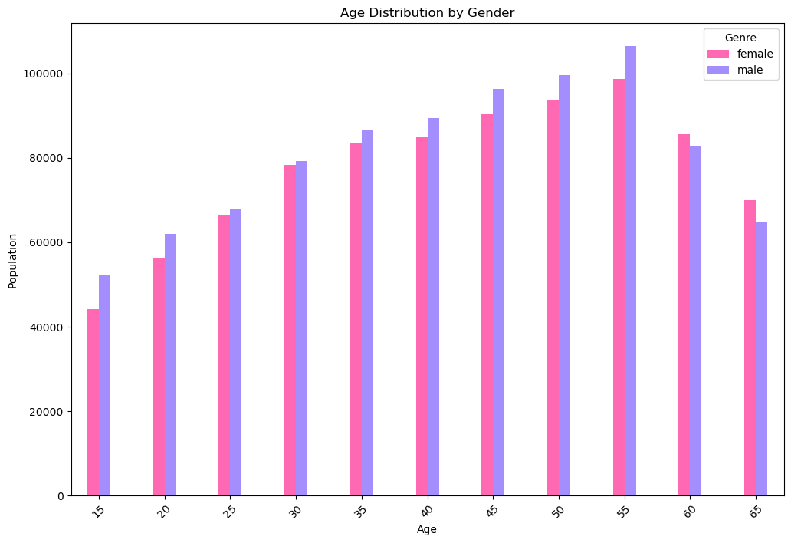
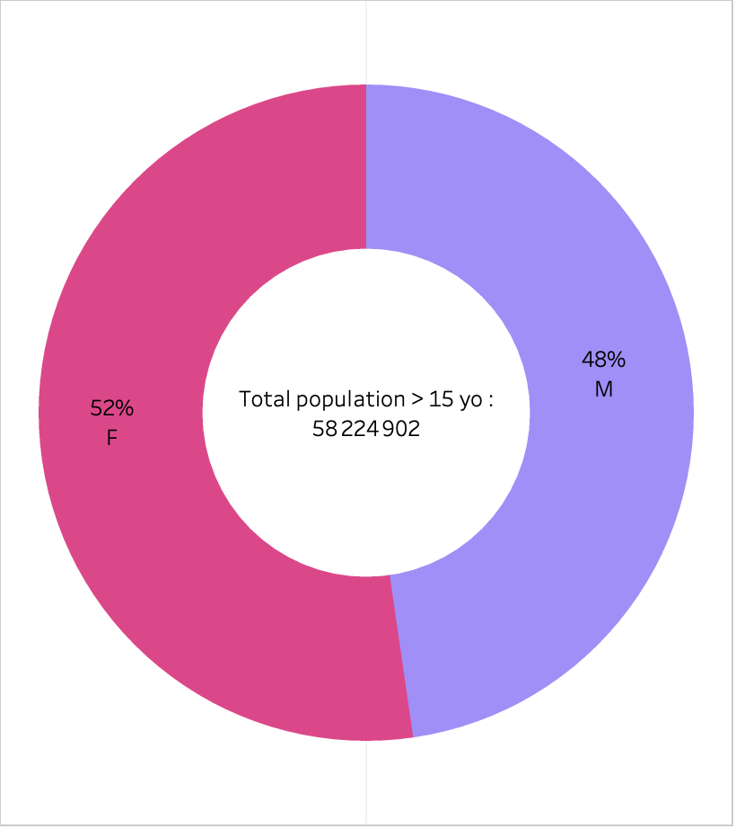
POPULATION INFOGRAPHICS BY GENDER
Young
Medium
Old
21

Slide 23
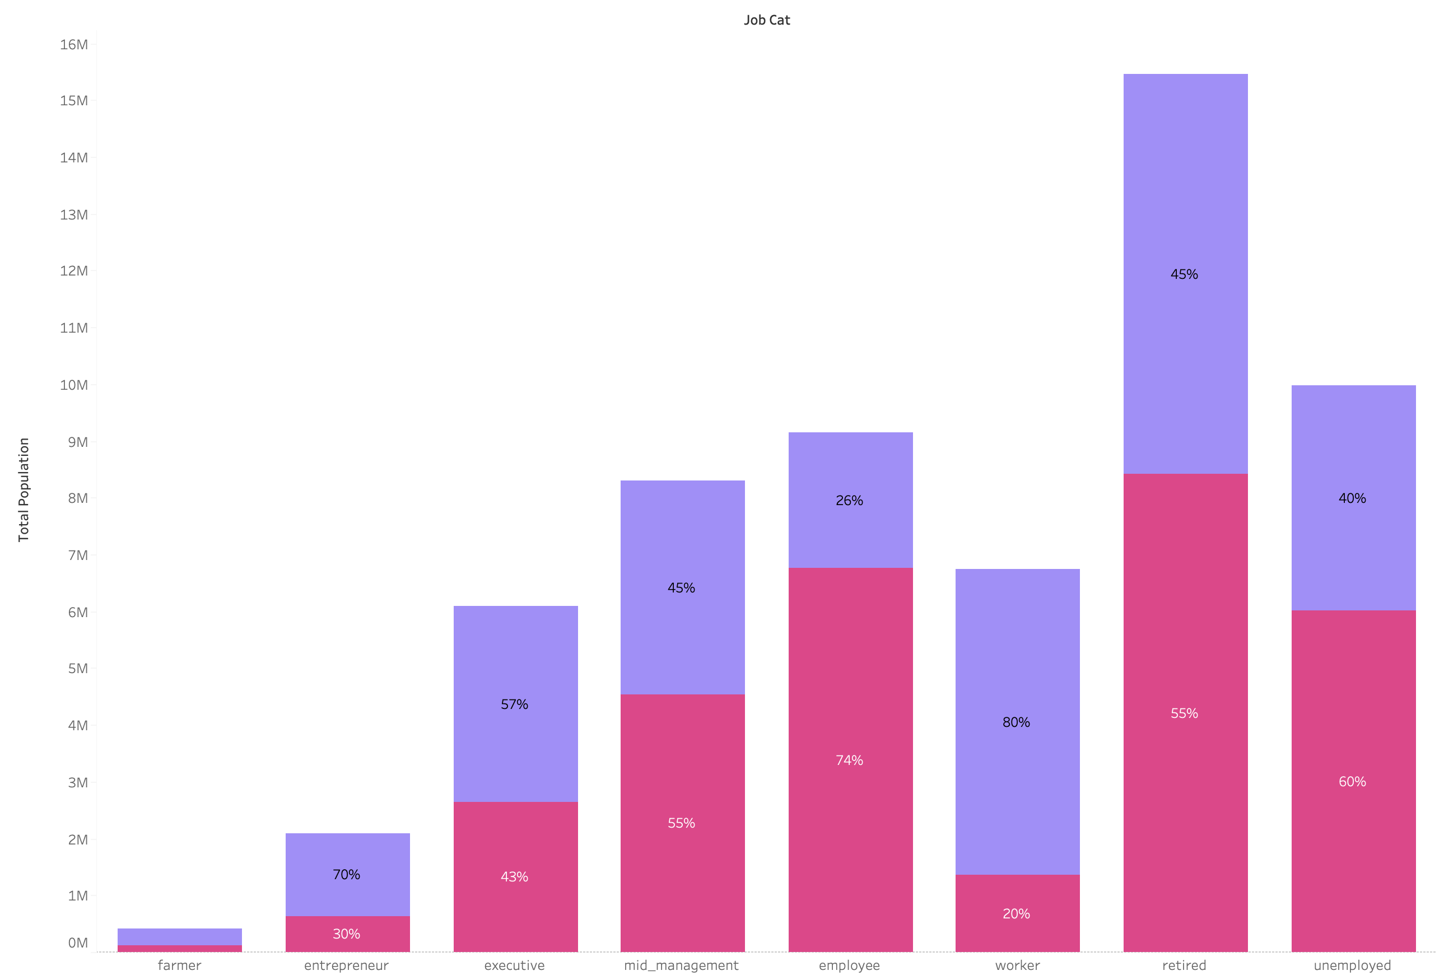
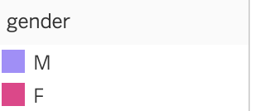
GENDER REPRESENTATION BY JOB CATEGORY
22

Slide 24
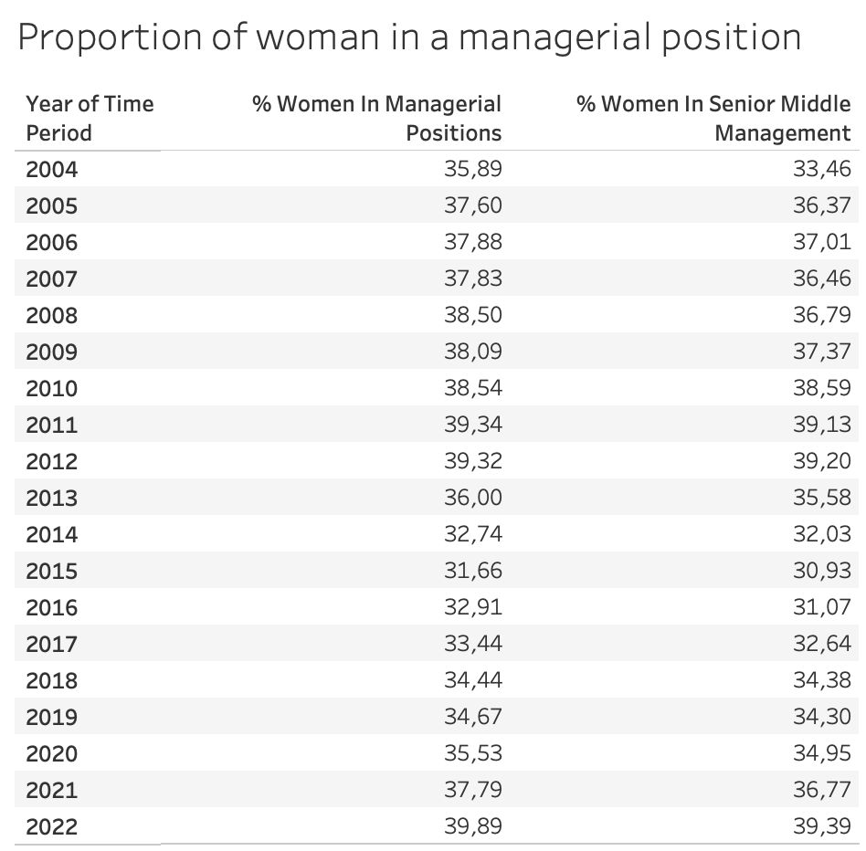
GENDER REPRESENTATION BY JOB CATEGORY
The joint calculation of these two measures provides information on whether women are more represented in junior management than in senior and middle management, thus pointing to an eventual ceiling for women to access higher-level management positions
23

Slide 25
GENDER REPRESENTATION BY JOB CATEGORY
24

Slide 26
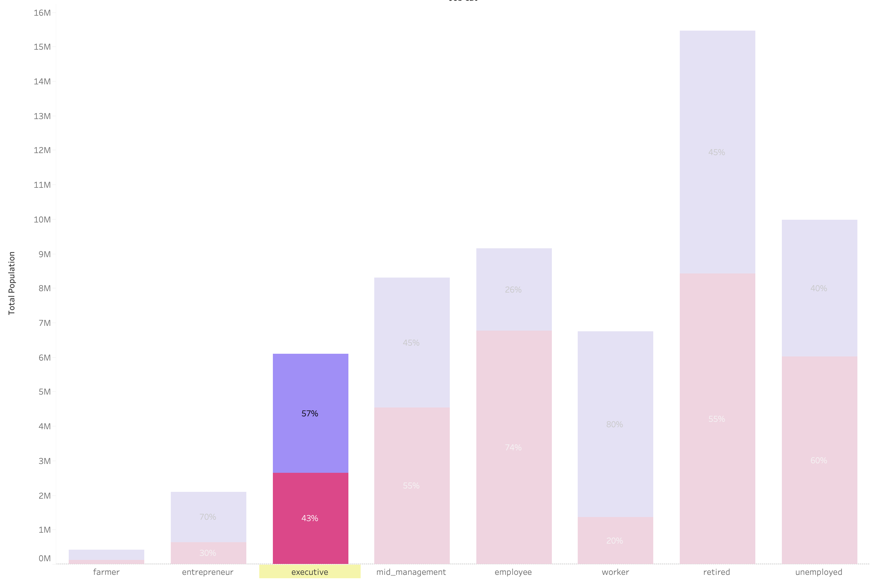
GENDER REPRESENTATION IN SENIOR MANAGERIAL POSITION
25

Slide 27
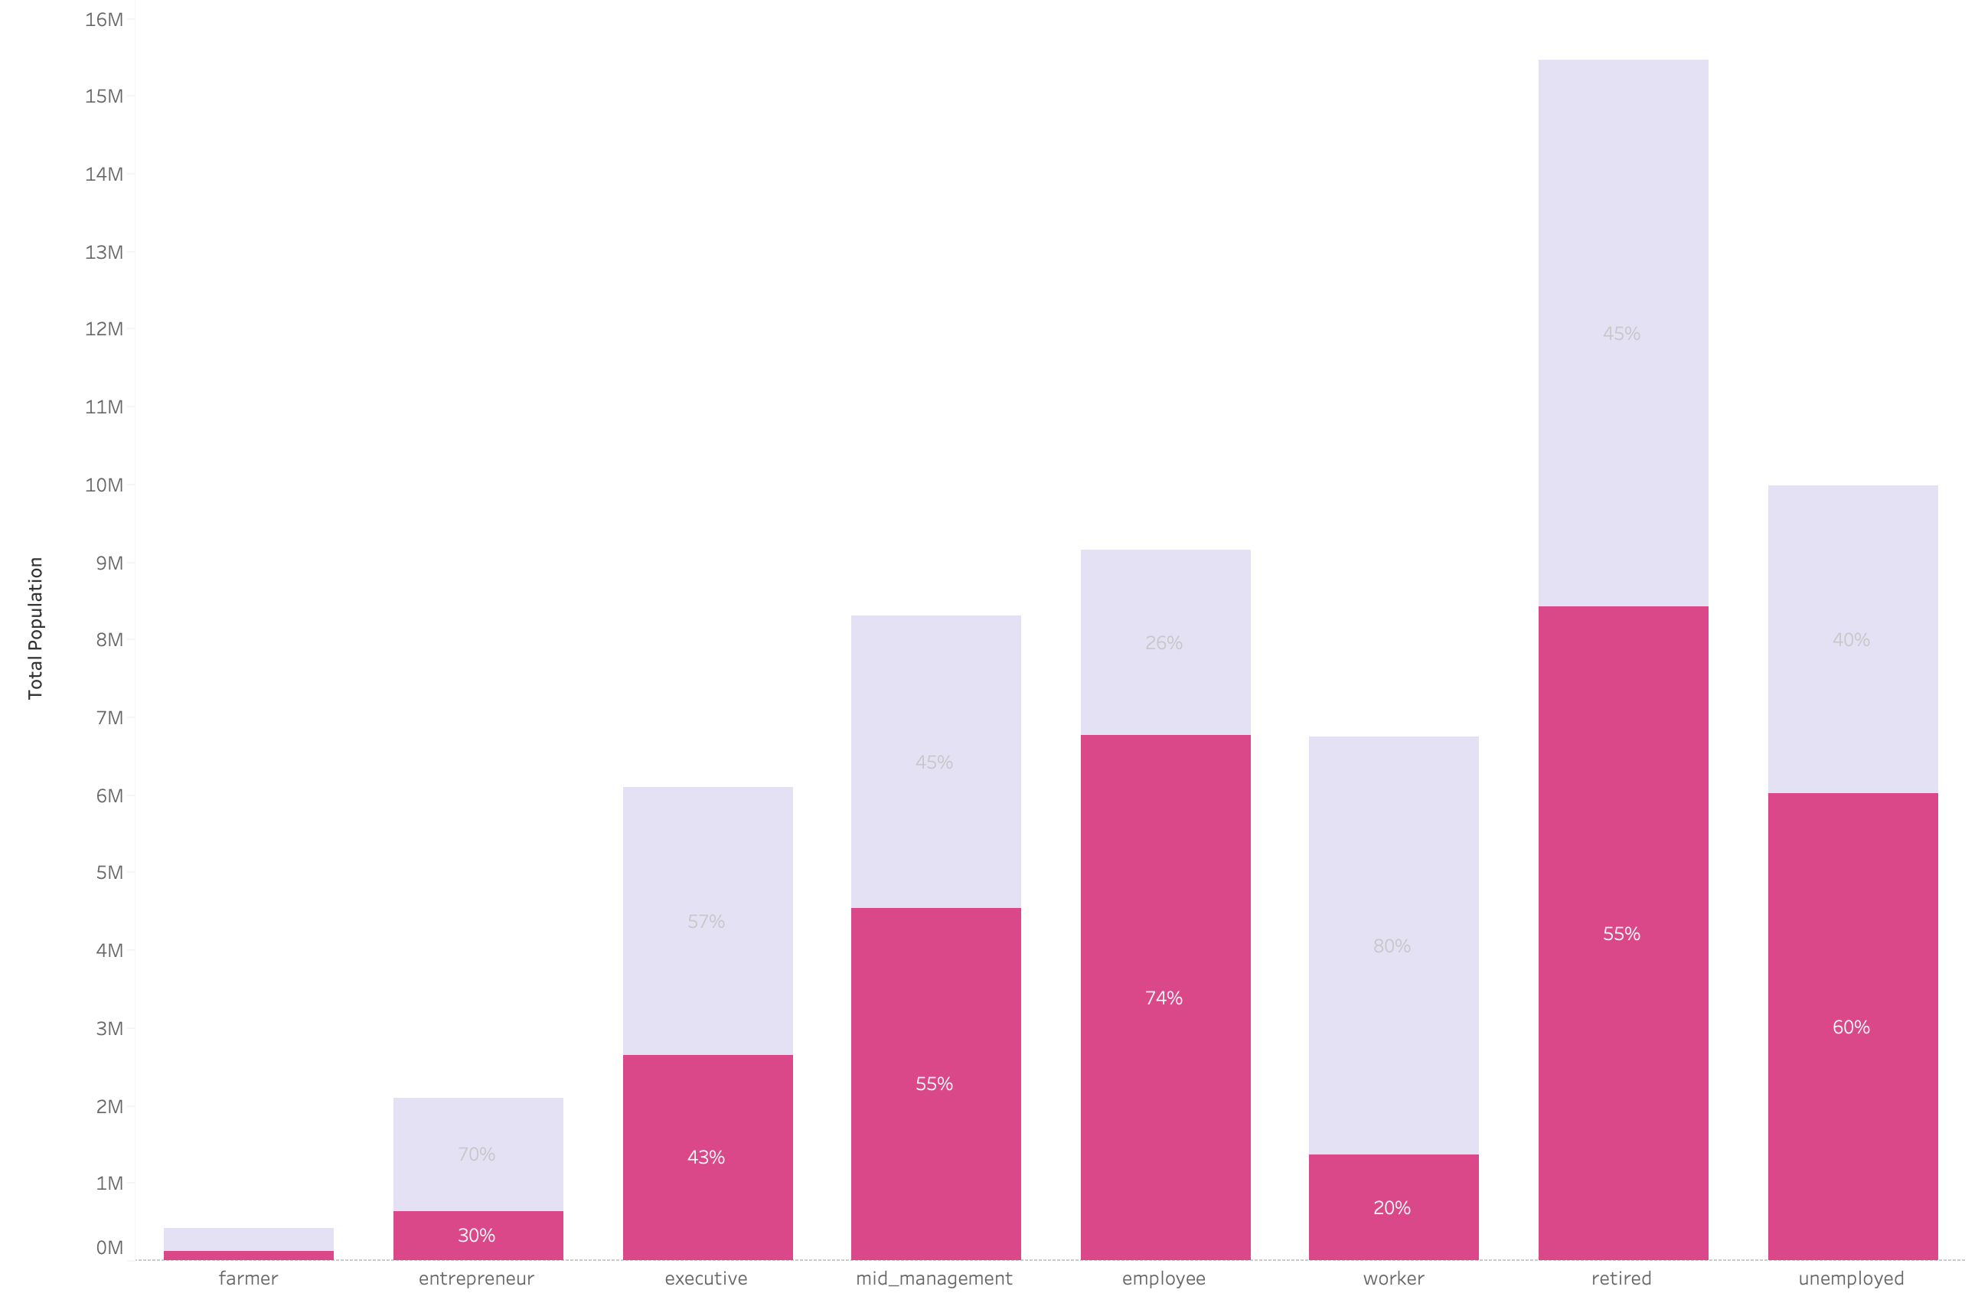
WOMAN REPRESENTATION BY JOB CATEGORY
26

Slide 28
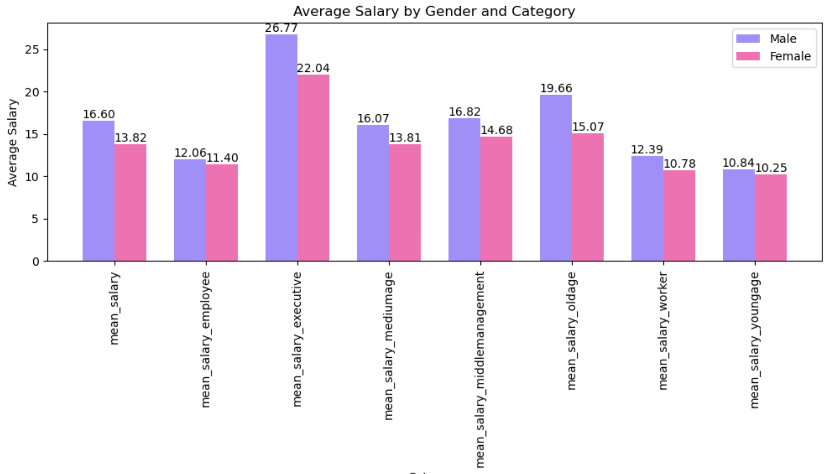
GENDER PAY GAP BY JOB CATEGORY
27

Slide 29
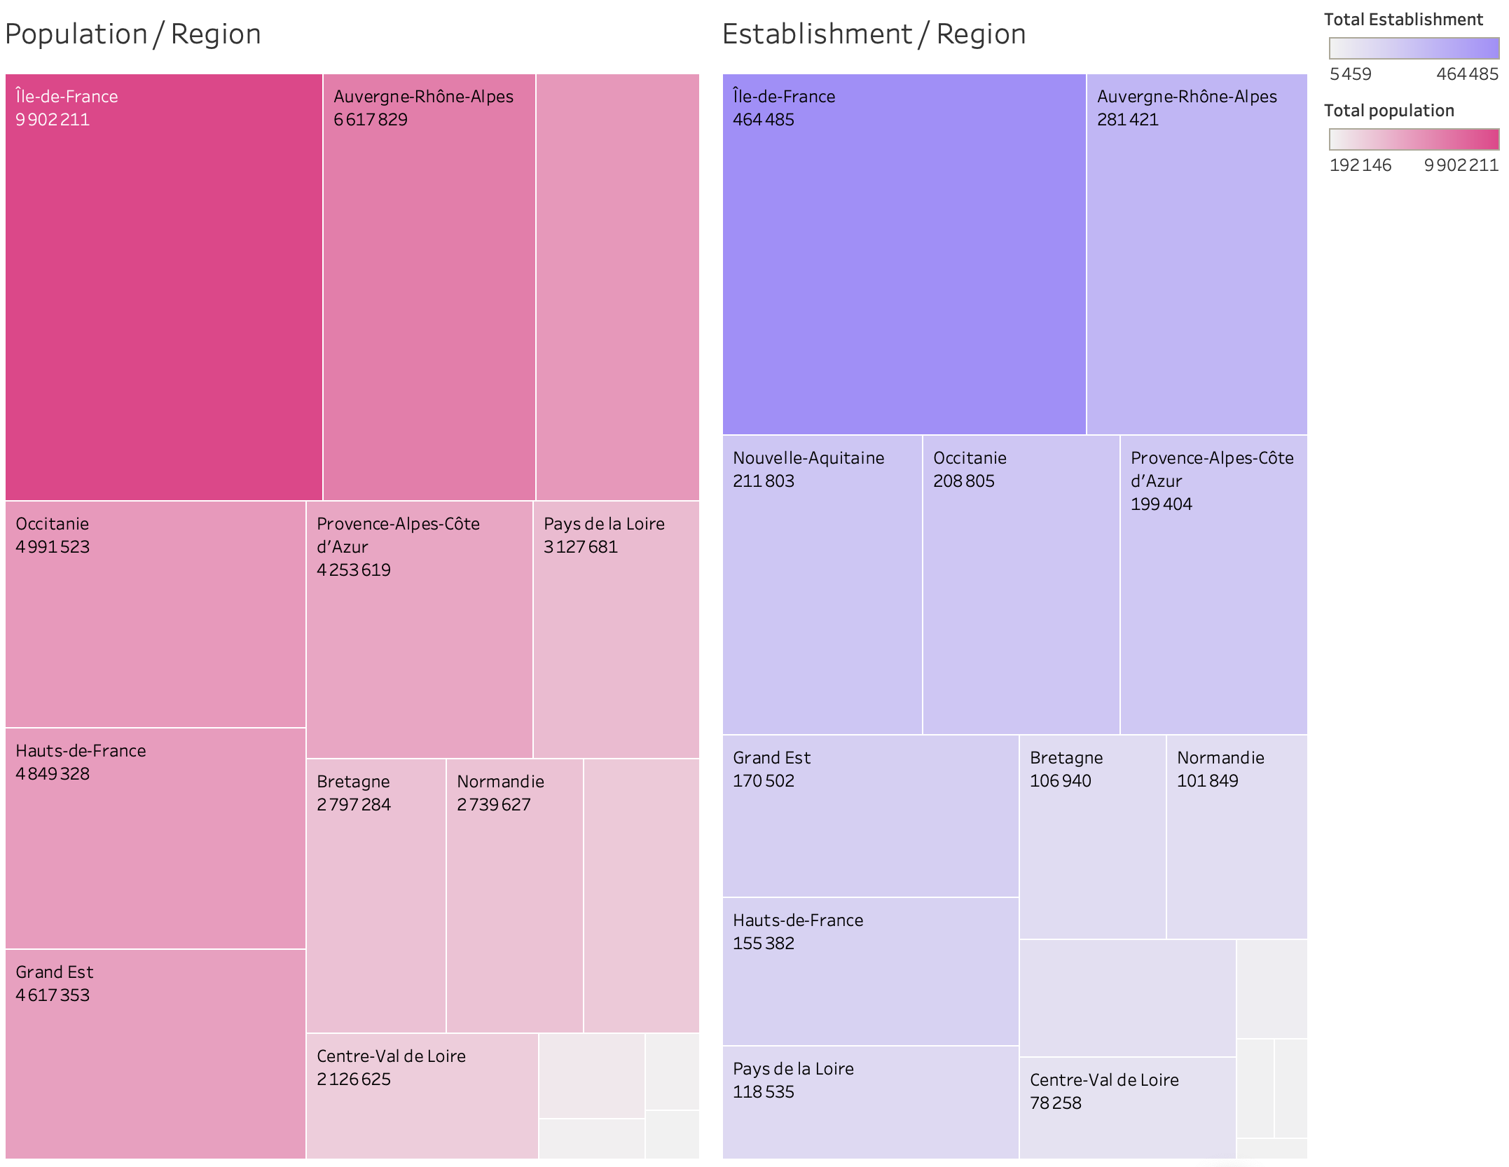
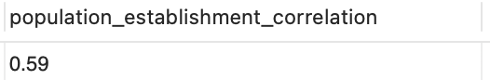
Population & establishment correlation
Pearson correlation =
28

Slide 30
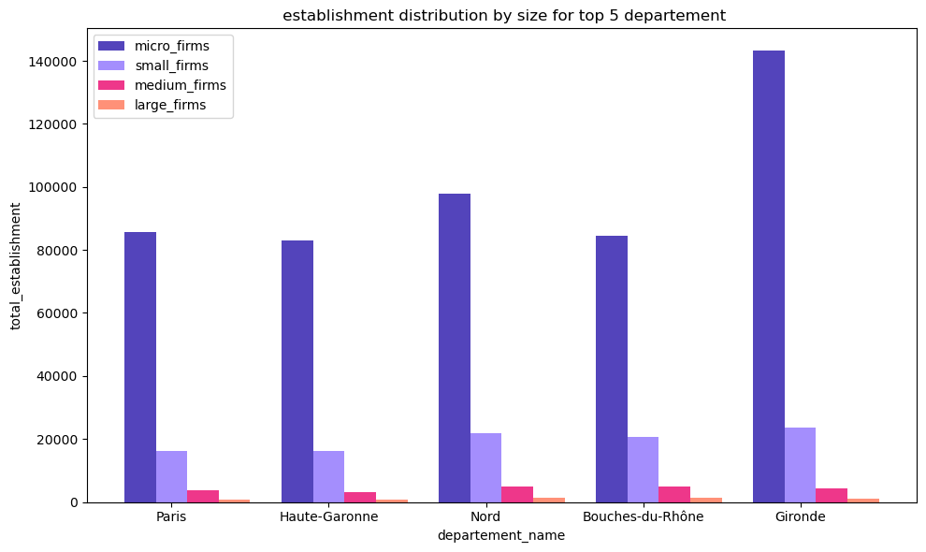
Population & establishment correlation
29

Slide 31
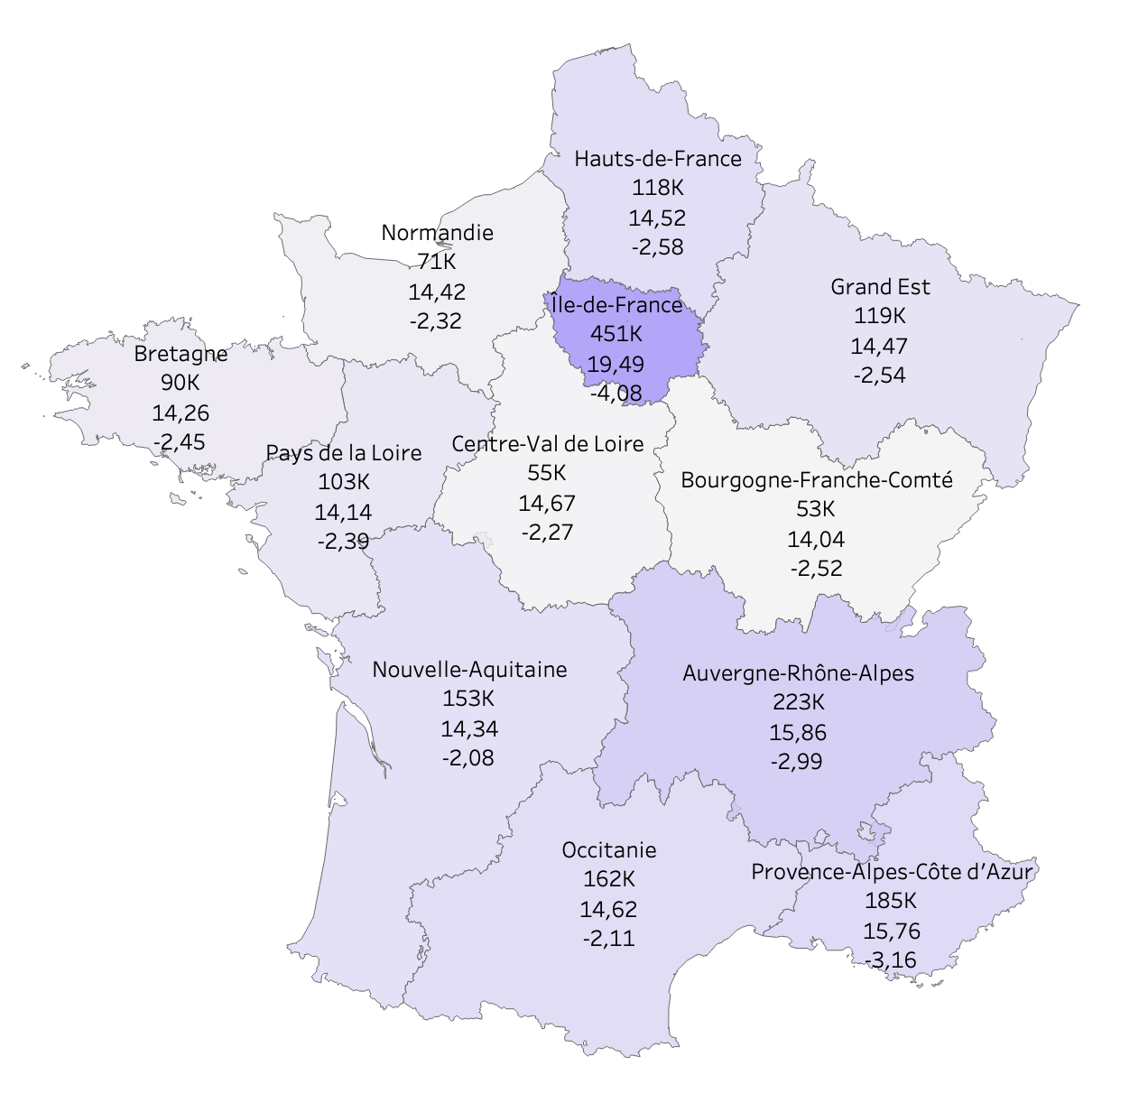
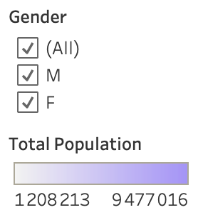
Regions most populated have a higher salary, but also a higher gender pay gap
Establishments, mean salary & paygap by region
30

Slide 32
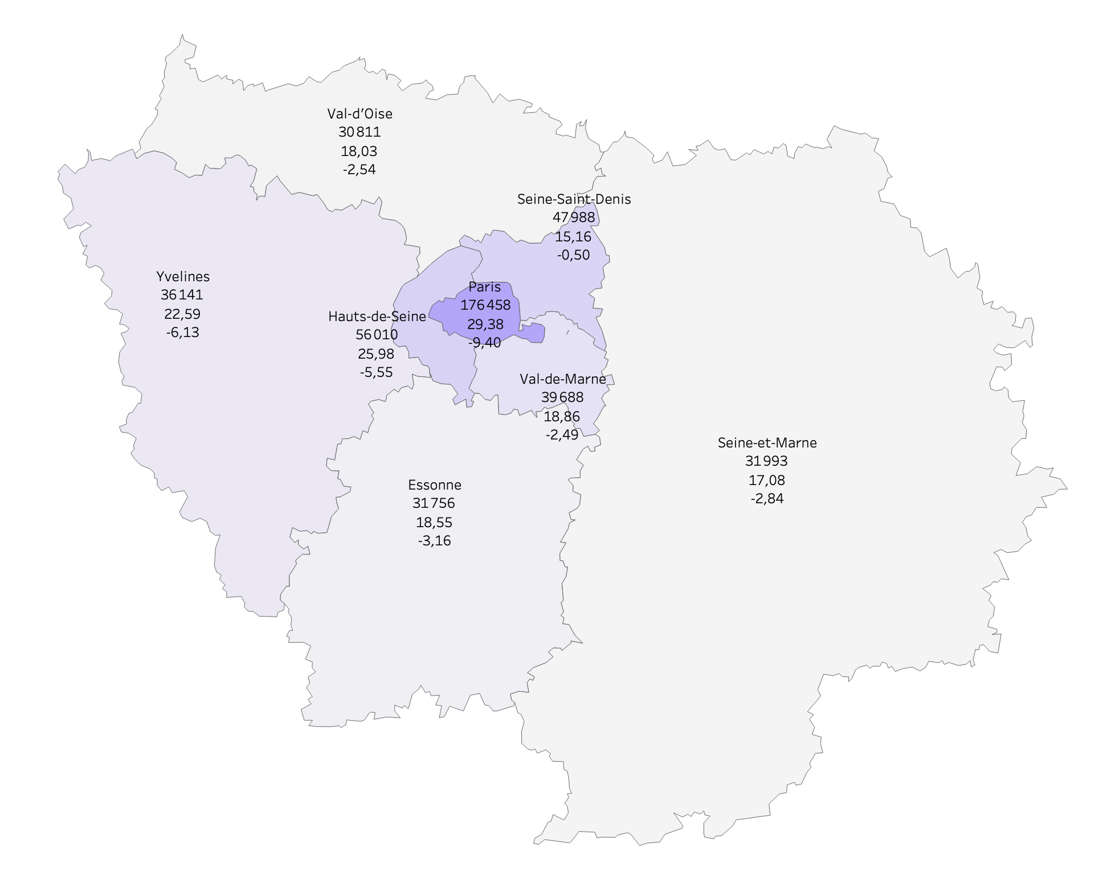
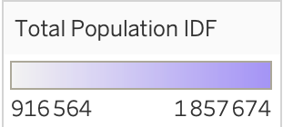
Regions most populated have a higher salary, but also a higher gender pay gap
Establishments, mean salary & paygap by region
Establishments, mean salary & paygap in IDF
31

Slide 33
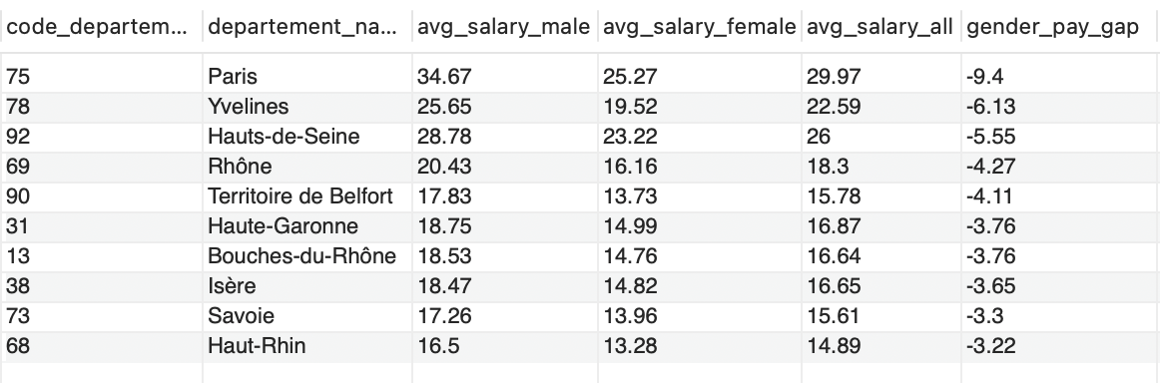
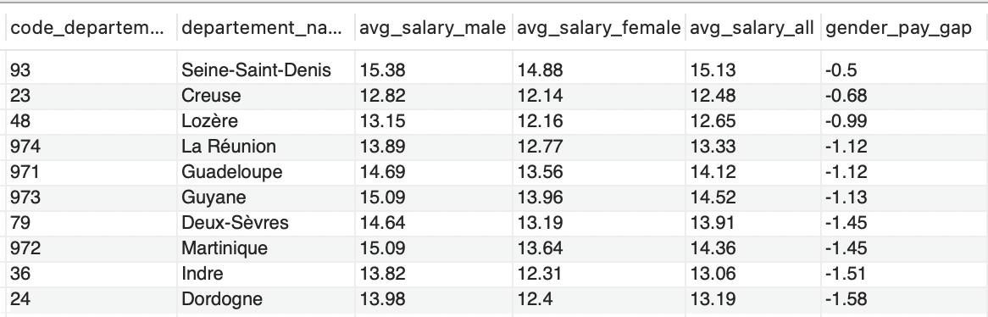
The pay gap is negative all over France
Top 10 – highest pay gap by department
Top 10 – lowest pay gap by department
32

Slide 34
05
DATA DISPLAYING
French Population, Establishments, and Salaries Insights API
33

Slide 35
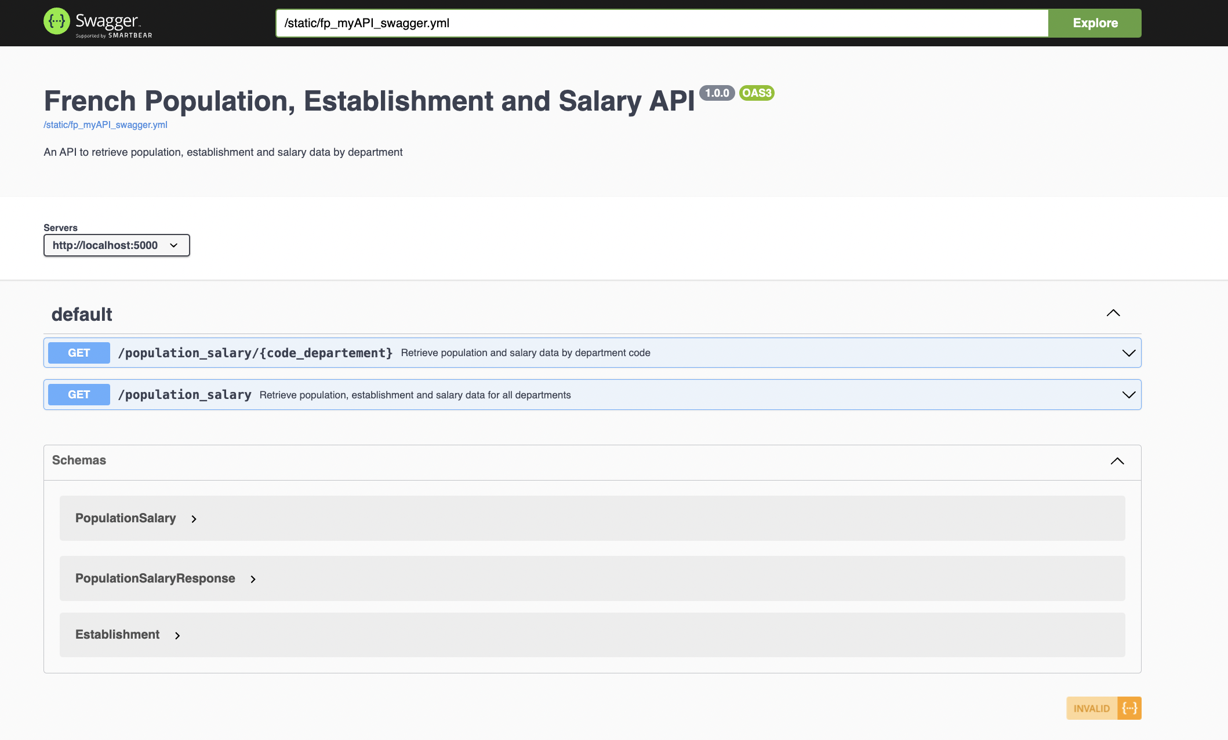

SWAGGER
This Swagger documentation outlines the structure of the French Population, Establishments, and Salaries API
34

Slide 36
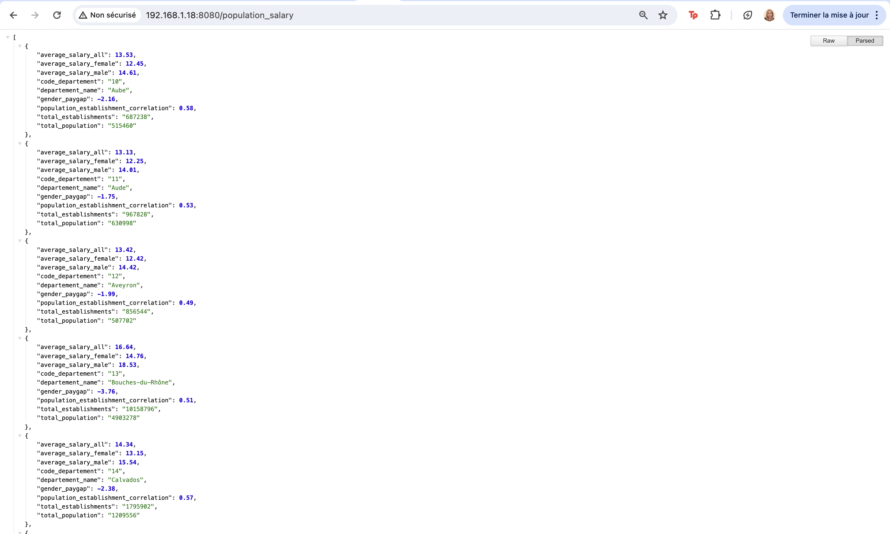
/population_salary
35

Slide 37
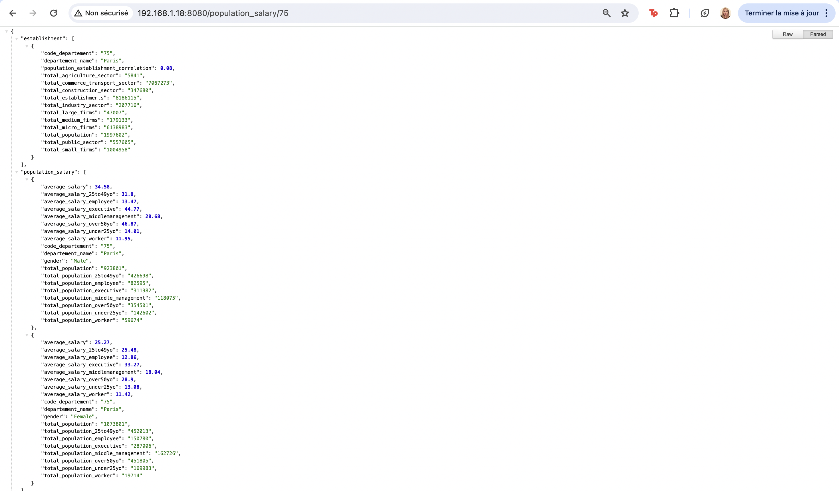
/population_salary/<code_department>
36

Slide 38
06
MACHINE LEARNING
Gender pay gap prediction within municipalities
37

Slide 39
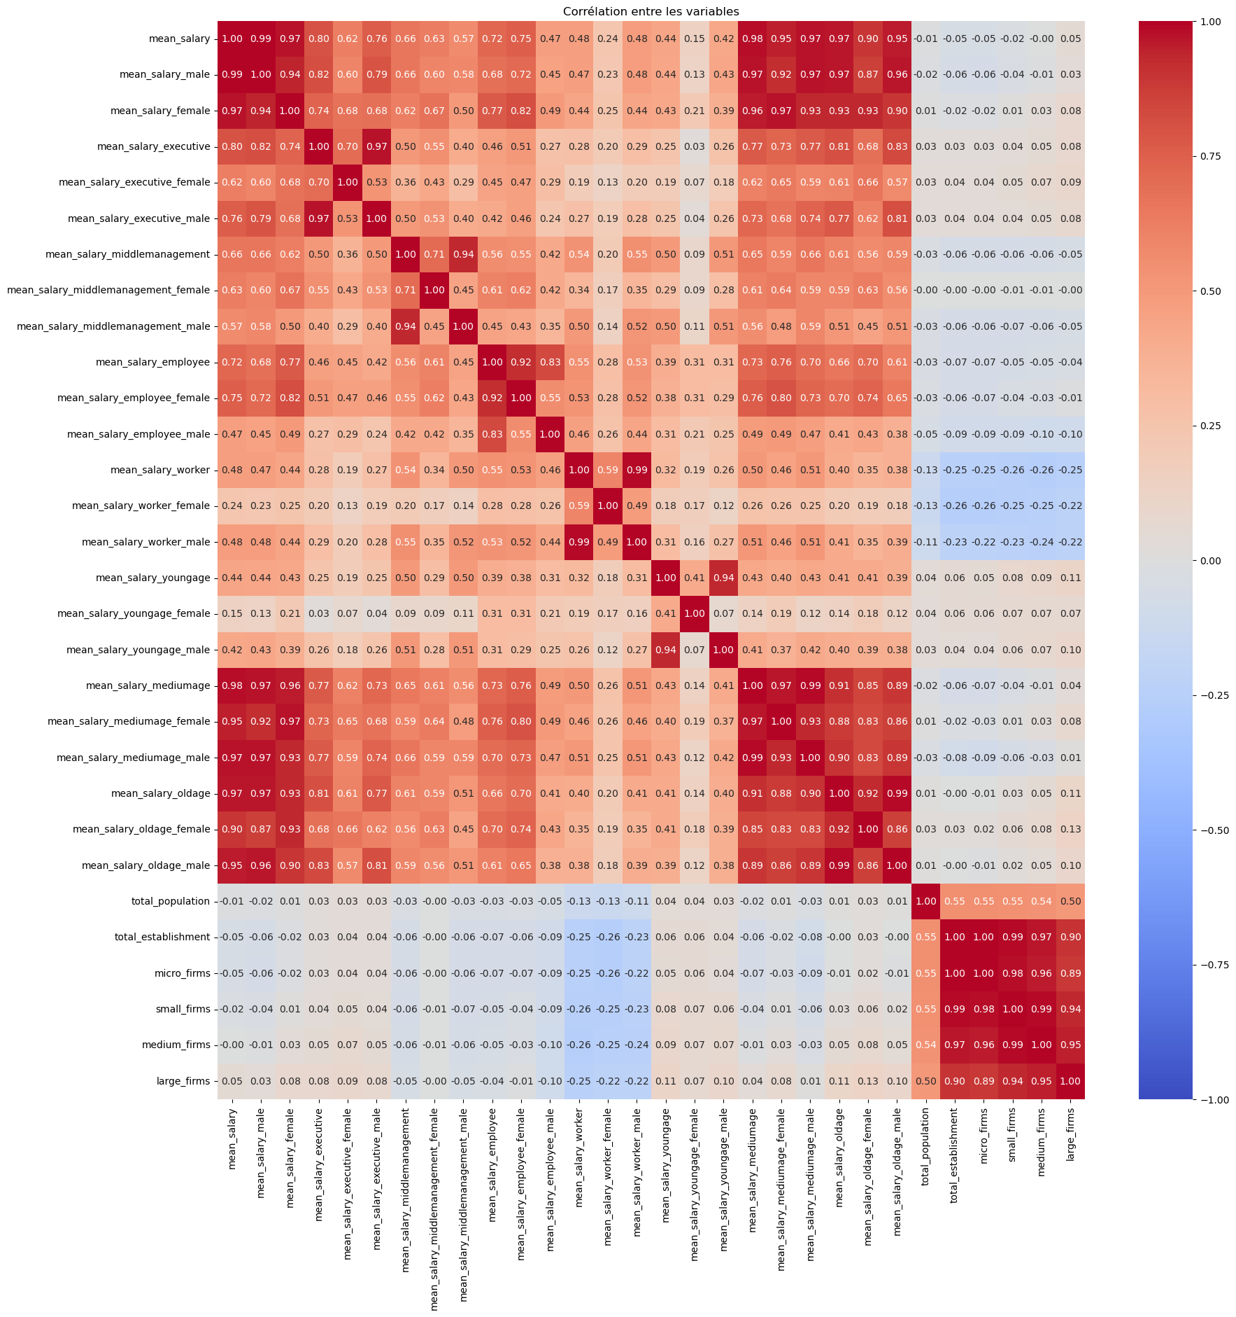
Correlation Matrix
Heatmap visualization of feature correlations to note potential relationships between features
Merged DataFrames establishment, geography, salary_all and population based on the CODGEO column
Selected columns for creating the heatmap, including various mean salary categories, total population, and establishment sizes
Calculated the correlation matrix between the selected variables
**salary_all = salary dataframe before normalization (male/female)
38

Slide 40
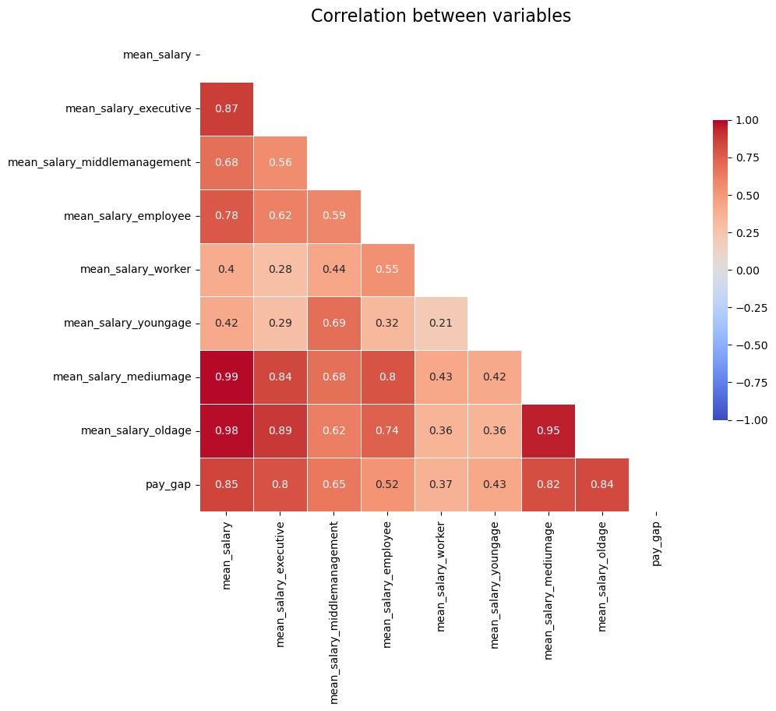
FEATURE ENGEENIRING
Features selection
Pay gap has a high correlation with the mean salary, the executive salary, and the middle and old age salaries.
39

Slide 41
MACHINE LEARNING OVERVIEW
Objective : | Predict the gender pay gap within various communes
Target Variable : | Pay gap defined as the numerical difference in mean salaries between genders
Regression Model Choice : | Effective for predicting numerical outcomes with linear or combined linear relationships between input variables (features) and the output variable (target) Our model will help analyze how different salary components, like mean salaries across various job categories and age groups, influence the gender pay gap
Model Selection : | Random forest regressor Bagging regressor with and without pasting AdoBoost regressor
40

Slide 42
EVALUATION METRICS
AdaBoost Regressor
Hyperparameter Tuning
Without HPT
Random Search CV
Grid Search CV
MAE 0.507
RMSE 0.703
R2 score 0.778
MAE 0.511
RMSE 0.714
R2 score 0.771
MAE 0.509
RMSE 0.705
R2 score 0.777
41

Slide 43
EVALUATION METRICS
Without HPT
Random Forest
Bagging
MAE 0.516
RMSE 0.711
R2 score 0.773
MAE 0.530
RMSE 0.724
R2 score 0.765
Bagging w/ pasting
MAE 0.528
RMSE 0.725
R2 score 0.764
42

Slide 44
EVALUATION METRICS
AdaBoost Regressor
Hyperparameter Tuning
Best parameters :
n_estimators: 1200
max_leaf_nodes: 2166
max_depth: 90
Random Search CV
MAE 0.507
RMSE 0.703
R2 score 0.778
41

Slide 45
07
CHALLENGES | NEXT STEPS
44

Slide 46

THANKS!
DO YOU HAVE ANY QUESTIONS?
pragassam.stephanie@gmail.com
45

